Slide 1


CONTEMPORARY WORLD
Dr. Jackelyn L. Legaspi
PROFESSOR

Slide 2

1.Social media has more negative than positive effects on mental health.
2.Technology is making us more isolated, despite being more connected.
3.Climate change is the most urgent global issue that needs immediate attention.
4.The rise of artificial intelligence will ultimately create more jobs than it eliminates.
5.College students today are under more pressure than previous generations.
6.Social media influencers have too much power and influence over public opinion.
7.The digital divide between developed and developing countries is widening.
8.Online education provides the same quality of learning as traditional in-person classes.
9.Globalization has led to the erosion of local cultures and traditions.
10.Privacy is a thing of the past in today’s digital world.

Slide 3

1. How might the global spread of tourism, as shown by famous landmarks from different countries, impact local cultures and traditions?
2. In what ways could this image reflect both the positive and negative effects of globalization?

Slide 4

GLOBALIZATION
is the process by which businesses, cultures, technologies, ideas, and people increasingly connect and interact across borders, leading to a more integrated and interdependent world. It involves the expansion of international trade, investment, communication, and the exchange of information, resulting in the acceleration of cultural, economic, political, and social interconnectedness. While it fosters global cooperation and the spread of innovation, it also raises concerns about inequality, and environmental impact. Globalization shapes the modern world by influencing local and global dynamics, from markets to human relations, across every aspect of society.

Slide 5

Economic Globalization
Economic globalization refers to the increasing interdependence and integration of national economies through trade, investment, and capital flows. It involves the expansion of markets and the global spread of goods, services, and financial systems.
Example: The rise of multinational corporations like Apple, which designs products in the U.S. but manufactures them in countries like China, and sells them worldwide. This is an example of the global integration of production and markets.

Slide 6

Cultural Globalization
Cultural globalization is the spread of cultural items—such as ideas, values, practices, and media—across the world, leading to cultural exchanges and the blending of cultures, or sometimes the dominance of one culture over others.
Example: The worldwide popularity of Hollywood movies, fast food chains like McDonald's, and social media platforms like Instagram, all of which have shaped global cultural norms and lifestyles.

Slide 7

Technological Globalization Globalization
Technological globalization refers to the global spread of technology and innovation, which facilitates communication, transportation, and the exchange of information across borders.
Example: The widespread use of smartphones and the internet, which connect people globally in real-time for communication, business, and entertainment, regardless of their geographic location.

Slide 8
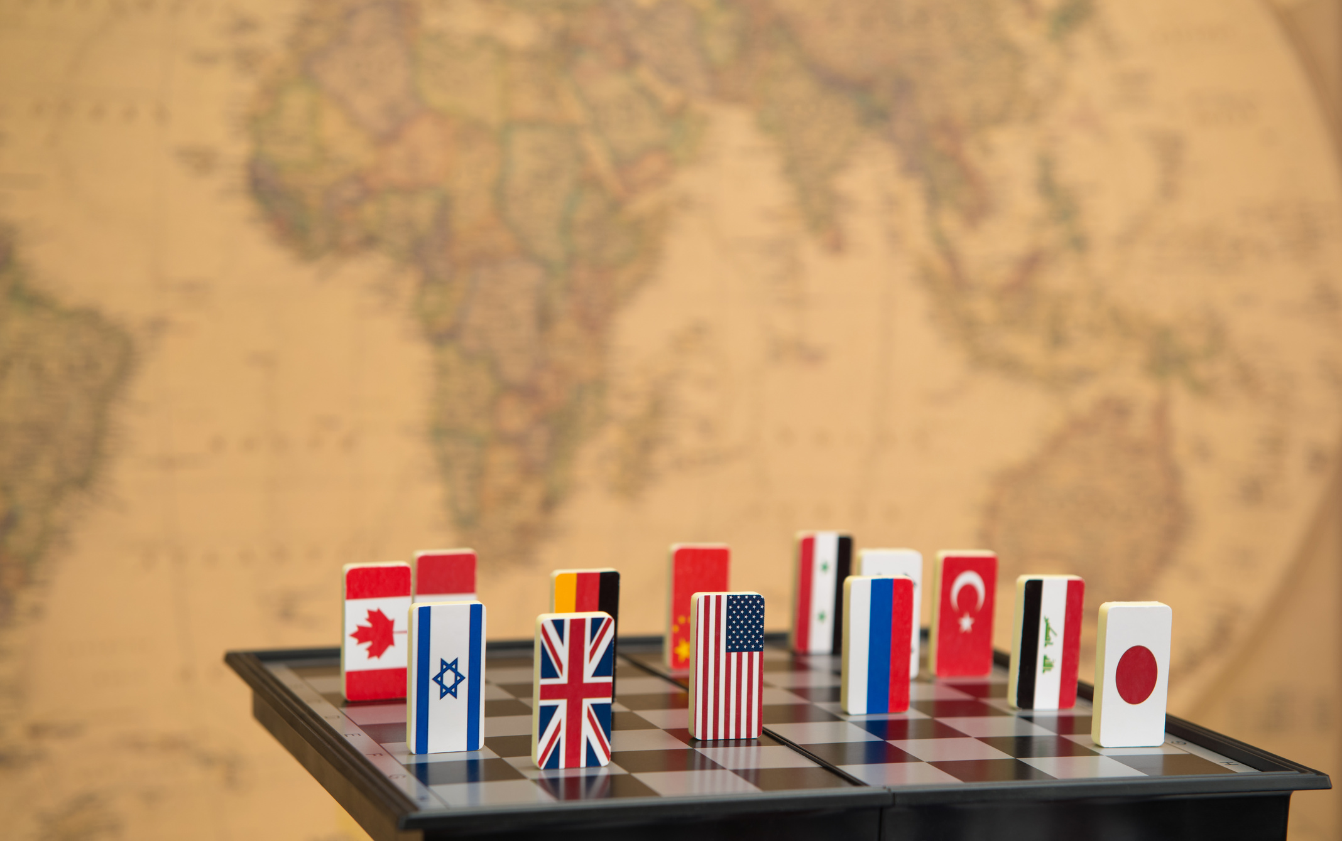
Political Globalization
Political globalization involves the increasing movement toward cooperation among governments, institutions, and international organizations to address global issues, such as climate change, trade regulations, and human rights.
Example: The establishment of the United Nations (UN), which includes countries from around the world working together to solve global problems like poverty, security, and human rights.

Slide 9
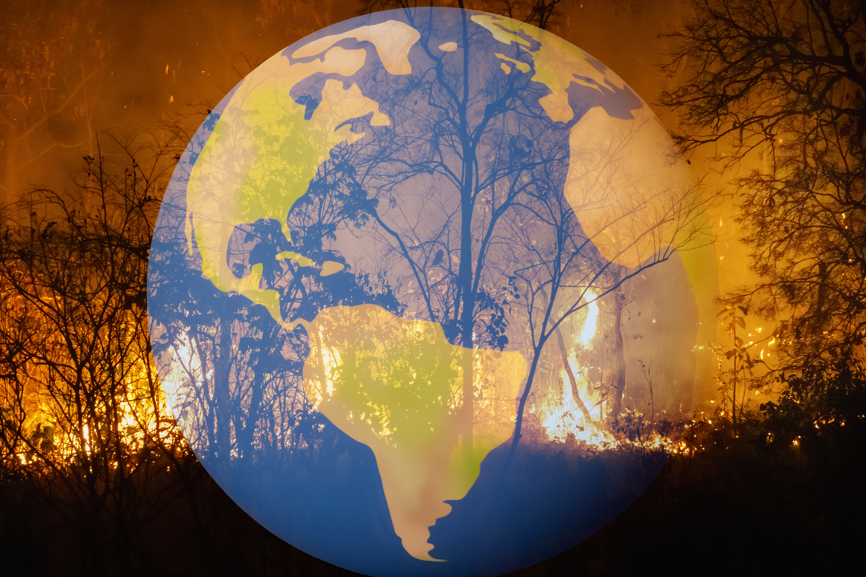
Environmental Globalization
Environmental globalization refers to the shared responsibility of countries to address global environmental challenges, such as climate change, pollution, and biodiversity loss, due to the interconnectedness of ecosystems and human activity.
Example: The Paris Agreement on climate change, where nations worldwide have committed to reducing carbon emissions and combating global warming, recognizing that environmental issues transcend national borders and require global cooperation.

Slide 10
ACTIVITY #1: Defining Globalization and Its Impact on the World
Objective:
The goal of this activity is to encourage students to critically analyze the concept of globalization and its far-reaching effects on the world. In this activity, each group will define globalization in their own terms and discuss its positive and negative impacts on different aspects of society, including economics, culture, politics, and the environment.

Slide 11

Instructions
Research and Discussion:
Each group should begin by discussing their own understanding of globalization. They can use class materials, online resources, or their personal knowledge to help shape their definition.
Next, groups should discuss the various impacts of globalization, focusing on multiple areas, such as:
Economic growth and inequality
Cultural exchange and cultural homogenization
Political power dynamics
Environmental consequences (e.g., resource use, climate change)
Each group should decide on the most significant positive and negative impacts they see in the world today.

Slide 12

INSTRUCTION
Create a Presentation:
After discussion, each group will create a short presentation (7-10 minutes) summarizing their definition of globalization and its key impacts.
The presentation can include visual aids (e.g., PowerPoint slides, images, video and short skit) to support their points.
All group members must contribute to the presentation, and each member should present part of the content.

Slide 13

INSTRUCTION
Class Discussion:
After all groups present, engage in a class-wide discussion where students can ask questions, offer feedback, and compare their perspectives on globalization.

Slide 14



Grading Criteria (100% Total)
Analysis of Impacts
(40 points)
Clarity and Depth of Definition (30 points)
. Group Collaboration and Engagement (20 points)
20 points: All members contribute meaningfully to the discussion and presentation, demonstrating effective collaboration.
15 points: Most members contribute to the discussion, but some members are less engaged or contribute minimally.
10 points: One or two members contribute to the majority of the work, with little input from the others.
0 point: The group works ineffectively, with little or no collaboration.
.
30 points: The group provides a clear, well-defined, and thoughtful explanation of globalization, incorporating various aspects such as its economic, cultural, and political dimensions.
20 points: The definition is clear but lacks depth or omits important aspects of globalization.
10 points: The definition is unclear or overly simplistic, and it does not adequately capture the complexity of globalization.
0 point: No definition is provided or the definition is irrelevant
Presentation Quality (10 points)
5 points: The presentation lacks organization, visual aids, or clarity in delivery. Several members appear unprepared.
0 points: The presentation is unorganized or not delivered effectively.
10 points: The presentation is well-organized, visually appealing, and engages the audience. All group members speak clearly and confidently.
7 points: The presentation is organized but may lack visual appeal or clear engagement. Some members may be less confident in delivery.

Slide 15

THANK YOU

